Slide 1


PPG Wood Introduction
Mar. 12, 2015
Confidential

Slide 2
PPG Industries, Inc
PPG工业公司
World leading supplier of coatings, glass, fiber glass, optical products and specialty products 全球领先的涂料、玻璃、玻璃纤维、光学产品和特种产品的生产商和供应商
Founded in 1883 成立于1883年
Global headquarter located in Pittsburgh, USA 总部位于美国宾夕法尼亚州匹兹堡市
Ranked on the Fortune 500 for 60 years since 1955 从1955年开始，连续60年位列美国财富500强
(2014年:PPG #170)

Slide 3
PPG Industries, Inc
PPG工业公司
PPG shares are traded on the New York Stock Exchange 股票在纽约证券交易所上市交易
Sales in 2014 are $15.4 billion 2014年销售额为154亿美金
More than 42,000 employees 全球雇员超过 42,000名
Have manufacturing facilities and equity affiliates in more than 60 countries 在全球60多个国家拥有业务机构和生产厂

Slide 4
Our Business
主营业务
  Performance Coatings 功能涂料 (39%)
    Aerospace 航空材料
    Architectural Coatings – Americas & Asia Pacific
    建筑涂料 – 销往美洲 & 亚太地区
    Automotive Refinish Coatings 汽车修补漆
    Protective & Marine Coatings防护和船舶涂料
  Industrial Coatings 工业涂料 (32%)
    Automotive OEM Coatings 汽车涂料
    Industrial Coatings (we are here) 工业涂料 (木器涂料在此)
    Packaging Coatings 包装涂料

Slide 5
Our Business
主营业务
  Architectural Coatings – EMEA
  建筑涂料–销往中东、欧洲、非洲 (14%)
  Optical & Specialty Materials
  光学产品 & 特殊材料 (8%)
    Optical Products 光学产品
    Silicas 硅化合物
  Glass 玻璃 (7%)
    Fiber Glass 玻璃纤维
    Flat Glass 玻璃

Slide 6
PPG China
PPG中国
One of the earliest global chemical companies to develop business in China in the late 1980s 80年代末最早在中国开展业务的全球性化工公司之一
More than 4,000 employees in China 在中国大陆员工人数超过4000人
Totally have 17 plants located in Tianjin, Shanghai, Suzhou, Kunshan, Zhangjiagang, Wuhu, Foshan, etc.在天津、上海、苏州、昆山、张家港、芜湖、佛山等地共设有17家工厂
Tianjin Plant is the first plant in China, and the biggest one of all PPG plants 天津工厂是PPG第一家在华工厂，也是PPG全球最大的涂料生产厂

Slide 7
PPG China Wood Coatings
PPG中国木器涂料
It has been over ten years since PPG wood coatings entered China. PPG木器涂料进入中国到目前为止已超过10年。
Wood Flooring—biggest business 地板涂料
PVC flooring and tiles PVC地板涂料
Wood Exterior (Joinery) 户外工业木器涂料
Wood Interior 室内工业木器涂料
Kitchen Cabinet 橱柜
Furniture 家具
Interior doors and windows 室内门窗
Sash/Shutter 室内窗框/气窗
Waterborne coatings 水性涂料

Slide 8

















PPG Wood Customers in Asia

Slide 9
Wood Flooring Coatings
地板涂料产品介绍
We have a complete coating system, including:
Stain and primers头道底漆和着色
UV Putty’s and Fillers UV补土和腻子
mainly for smooth flooring filling the flooring surface
Sealers底漆
Topcoats面漆

Slide 10
Wood Flooring Coatings
地板涂料产品介绍
Stain
色精 dye：
1. 水油通用色精 / dye shared in solvent borne and waterborne，
PPG现有产品 / PPG existing products: A389A39TJM, A385B39TJM, A397D39TJM
A005A, A003B, A007D, A004E
2. 醇水色精 / dye for waterborne
PPG现有产品 / PPG existing products: A015A, A013B, A017D, A001C39
色浆 Tint (or pigment)
1. 透明水性色浆 / transparent waterborne tint
PPG现有产品 / PPG existing products: WBC-023-1-26
WBC-021-1-260901, WBC-022-1-2603,
2. 普通水性色浆 / Normal waterborne Tint
PPG现有产品 / PPG existing product: WVA705, WVA703, WVA772, WVA775, WVA723,
080-0-0262, A718E39TJM, A719E39TJM
3. UV色浆 / UV Tint
PPG现有产品 / PPG existing product: R025A, R023B, R027D, R026W, R1164W74TJM

Slide 11
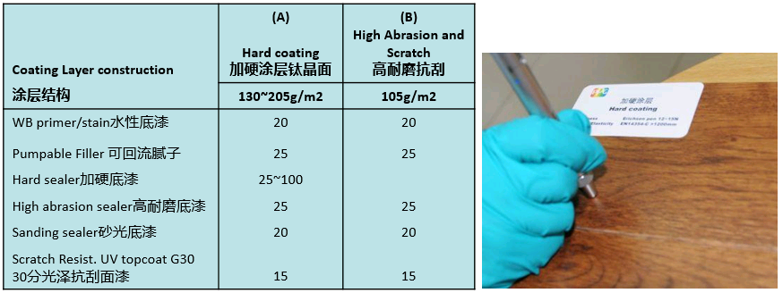
High Performance Coating System
高性能产品体系
加硬涂层体系/hard system: 能满足/can meet ASTM D3363 (Ericsen 318 pen) 12-15N，同时满足冲击力/柔韧性 and also with good flexibility and anti-impact: EN14354-C (Steel ball, 324+/5g, 42.8+/-0.2mm): >1000mm (solid wood)

Slide 12
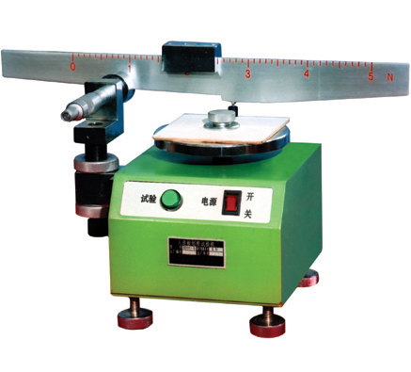
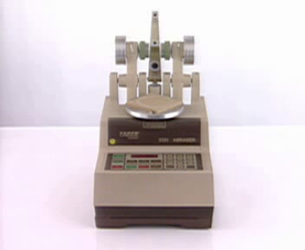
High Performance Coating System
高性能产品体系
耐磨涂层体系 / abrasion resistant system:
  北美标准 NA Standard: ASTM D4060/S-33 家居实木地板household solid wood flooring>500cycles，商用实木及复合地板commercial solid wood flooring or engineered flooring>1000cycles
  超级耐磨产品 super anti-abrasion product：ASTM D4060/S-33 > 2000cycles
  国标 National standard: GB/T 18103: <=80mg/100cycles
  欧洲标准EU standard: 满足meet EN 14354（落沙耐磨 shakeout abrasion test）WR3>=7000cycles
纳米涂层体系：很好的保光性，能在CS-17砂轮225cycles后保持80-100%的光泽;能满足细的摩擦介质0000#钢丝棉和中等粗糙级别的Scotch Brite：>3000cycles
Nano system: good gloss retention, can maintain 80~100% gloss level after 225 cycles with CS-17 Grinding Wheel, can pass 0000# steel wool and middle level of Scotch Brite.

Slide 13
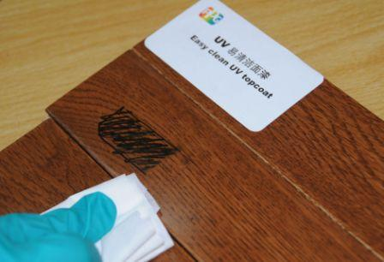
High Performance Coating System
高性能产品体系
易清洁涂层体系：表面张力低，抵抗各种溶剂或水性涂鸦，使其不浸润，能满足EN 438-2最高抗污等级：level 5
easy-clean system: low surface tension, resist various solvent or waterborne marker, hard to be wetted, can meet EN438-2’s highest level

Slide 14
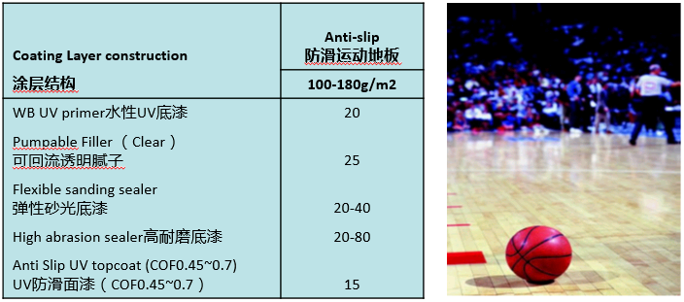
High Performance Coating System
高性能产品体系
防滑涂层体系：能满足ASTM D2047 COF>0.45的北美家居地板防滑要求，更高的防滑系数COF:0.5-0.7可满足体育场馆及公共场所防滑要求
anti-slip system: can meet NA household flooring request of ASTM D2047 COF>0.45. Public area and gym need COF: 0.5~0.7

Slide 15
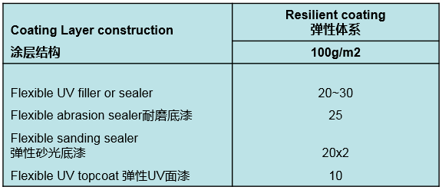
High Performance Coating System
高性能产品体系
弹性体系：涂膜有极好的柔韧性，涂层饱满透明、木纹清晰、表面细腻，COF> 0.45，同时兼具良好的耐磨和抗刮性S33>500, 0000#钢丝棉/steel wool> 100
elastic system: excellent film flexibility, transparent and saturate film, smooth surface, COF>0.45, good abrasion resistance and anti-scratch.
Protect wood from cracking, suitable for Hickory, cork and plastic impregnanted wood
适于软木、山核桃木和塑胶浸渍强化的一些易开裂木质薄板

Slide 16
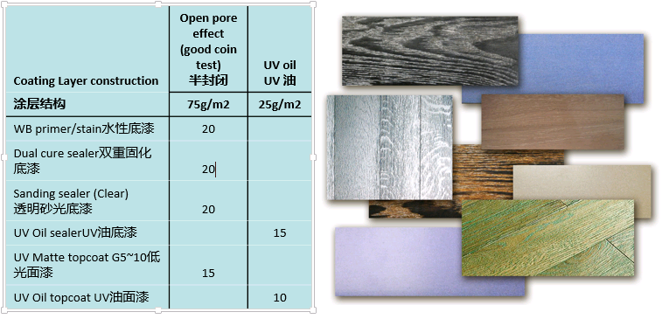
High Performance Coating System
高性能产品体系
特殊效果涂层体系：适合于特殊要求的商用复合贴面地板和实木地板，主要效果为：裂纹效果、皱纹效果、金属闪光效果等
special effect coating system: base on special request, main effects are-cracking, wrinkling, metal sparkling etc.

Slide 17
High Performance Coating System
高性能产品体系
封油涂层体系：水性封油、PU封油、2K双重固化底漆封油
oil sealing system: waterborne/PU/2K duel cure sealer for oil sealing
软木涂层体系：能满足EN 438 4-5级抗污要求，保证柔韧性的同时满足ASTM D4060 S-33\S-42耐磨要求
cork wood coating system: can meet anti-dirt EN 438 4-5 request, abrasion resistant ASTM D4060 S-33\S-42 and maintain the flexibility
UV油涂层体系：低膜厚、自然超低光泽、优良的防水抗污性
UV oil coating system: low FB, natural matt gloss and good waterproof anti-dirt performance
UV印刷涂层体系：适用于MDF\HDF\复合贴面地板、竹木地板等底材，形成自然逼真的木纹效果
UV printing system: suitable for MDF\HDF\laminate veneer flooring\bamboo flooring etc. with vivid appearance

Slide 18
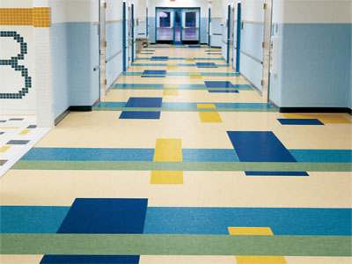
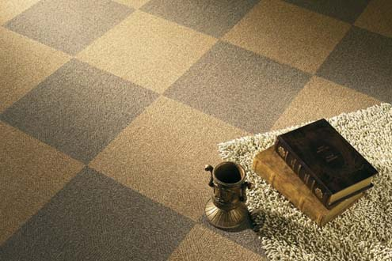
High Performance Coating System
高性能产品体系
PVC涂层体系：优良的耐化学性、硬度、柔韧性等，适用于PVC塑胶地板涂装，可选一途或两涂体系
PVC coating system: good chemical resistance, hardness and flexibility. Suited for PVC plastic flooring coating, 1 layer or 2 layers system for option.

Slide 19
PPG Wood Coating Character and Advantages
PPG木器涂料特点及优势
The best unique wood protective products with high performance
产品有针对性、高性能、品质稳定
Wide product range in many technologies base on global platform
We also have the best control on formula version and product code
有全球统一的技术平台，有不同应用和技术类型的全套涂料体系满足各种性能 要求.同时有严格的配方版本和产品编号控制系统。
Reliable customer service and experienced technical support
可信赖的客户服务和专业的技术支持
Compliance with environmental regulations
完全能够通过相关的环境安全健康要求

Slide 20
PPG Wood Coating Character and Advantages
PPG木器涂料特点及优势
Complience with environmental regulations, our EHS compliance and certifications of PPG Tianjin Plant include：
完全能够通过相关的环境安全健康要求，我们的产品安全符合性和PPG天津工厂所通过的产品和体系的认证包括：
  ISO 14001
  The best and strict certification for Automotive
  GB 18581-2001
  Limit of harmful substances of solvent-base coatings for woodenware
  GB 18584-2001
  Limit of harmful substances of wood furniture
  RoHS 2002/95/EC
  Restrict 6 substances Pb, Hg, Cd, Cr(VI), PBB and PBDE
  REACH Regulation 1907/2006/EC
  Restrict 15 SVHC

Slide 21
PPG Team
“Focus-on-customer” culture
Offer best technical service
Total operation cost effective
Build the professional TSR team & responsibilities
  Co-work with customer to manager paint materials.
  Quality checks & Improvement.
  Trouble shooting & Problem solving.
  Periodically having a meeting with customer to trace continuous improvement.
  Technical Training.
PPG Commit to quickly respond and feedback to customers’ request in 24 H
  Orders response in 24H
  Trouble-shooting. TSSR to be on line in 24H to fix the issue

Slide 22
PPG Team
Professional launch team specifically dedicated to successful product launch and troubleshooting
  Line survey
  Pre-trial in lab per Secure Launch Process
  Trials. We can improve the line trail successful ratio
Manufacture locations
  North/East/South manufacture location-TJ/SH/Guangdong

Slide 23
Value Added Service
To leverage PPG global color styling expertise to help customer on color design
Technical service expertise helping customer control the applied cost and AMU at customer site
Technical training and trouble shooting training to customers regarding customer production line

Slide 24

www.ppg.com
Confidential

